Slide 1
Unit 3B
Human Form & Function
Body systems
The endocrine system

Slide 2

Study Guide
Read:
Our Human Species (3rd edtn)
Chapter 9
Chapter 16, section 4
Complete:
Human Biological Science Workbook
Topic 10 – The Endocrine System

Slide 3
The endocrine system
The endocrine system comprises a group of ductless glands that secrete chemical messenger substances, called hormones, into the bloodstream.
Hormones are responsible for the long-term regulation of many bodily functions.
The endocrine system includes the pituitary, thyroid, parathyroid, thymus and adrenal glands, and the pancreas and gonads (ovaries and testes).

Slide 4
Hormones
Hormones are:
  chemical messengers
  mostly proteins, amines (small molecules derived from amino acids) or steroids
  secreted by endocrine glands (glands without ducts)
  carried in bloodstream to target organs
  change the way in which cells function
  target specific

Slide 5
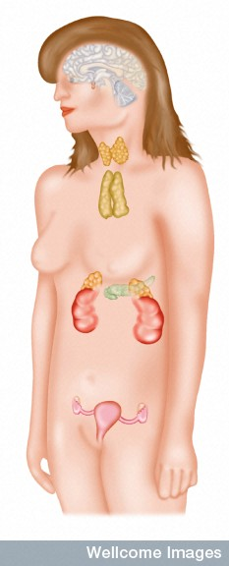
The endocrine glands
Pituitary
medulla & cortex
Thyroid & parathyroids
Thymus
Adrenal
medulla & cortex
Pancreas
ilets of Langerhans
Gonads
ovaries in females
testes in males
Many organs perform endocrine functions e.g. the hypothalamus, digestive tract, liver and kidneys.
Wellcome Photo Library

Slide 6
Action of protein and amine hormones
Blood
capillary
Hormone
Membrane receptor
Cell membrane
Cyclic AMP
formed
c-AMP alters cell metabolism

Slide 7
Action of steroid hormones
Blood
capillary
Hormone
Cell membrane
Membrane receptor
Hormone activates
cell's DNA

Slide 8
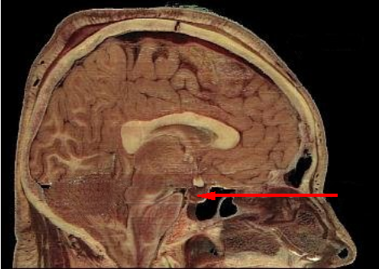
Pituitary gland - 1
The pituitary gland is:
a pea-sized structure located at the base of the brain.
an extension of the hypothalamus.
consists of an anterior lobe and a posterior lobe.
produces hormones that control other glands and many body functions.

Slide 9
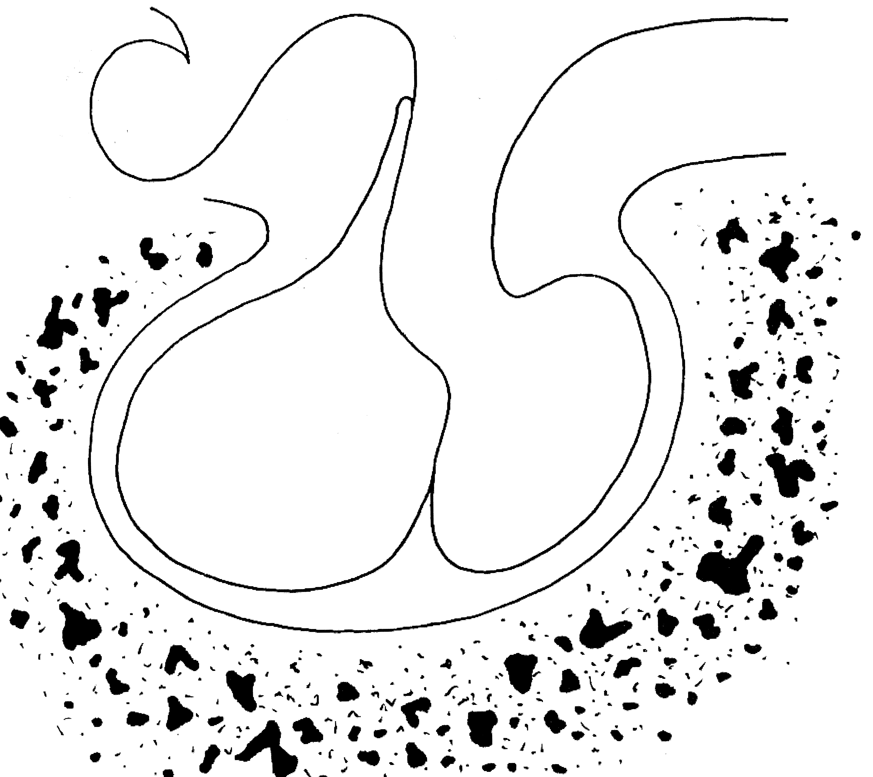
The pituitary gland
HYPOTHALAMUS
ADH & oxytocin carried from hypothalamus
Hypothalamus secretes releasing factors
ADH & oxytocin carried from hypothalamus
INFUNDIBULUM
Thyroid stimulating hormone
Adrenocorticotropic hormone
Gonadotropic hormones (FSH & LH)
Growth hormone
Prolactin
Antidiuretic hormone
Oxytocin
ANTERIOR LOBE
POSTERIOR LOBE

Slide 10
Posterior pituitary gland
Gland | Principle hormones | Action
Posterior pituitary gland | Antidiuretic hormone (ADH) | Regulates water reabsorption from kidneys
 | Oxytocin | Allows milk letdown/suckling reflex Initiates labor Maternal behaviour

Slide 11
Anterior pituitary gland
Gland | Principle hormones | Action
Anterior pituitary | Thyroid stimulating hormone (TSH) | Regulates thyroid gland
 | Adrenocortico trophic hormone (ACTH) | Regulates adrenal cortex
 | Gonadotrophic hormones Follicle stimulating hormone (FSH) Luteinising hormone (LH) | Regulates gonads
 | Growth hormone (GH) | Regulates growth in children
 | Prolactin | Regulates milk production

Slide 12
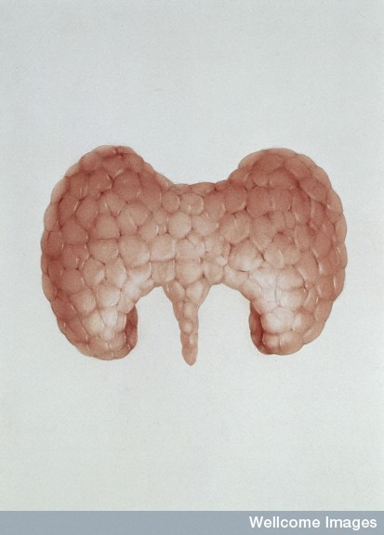
The thyroid and parathyroid glands
The thyroid gland is wrapped around the larynx (Adam’s apple).
Four small parathyroid glands are embedded in the thyroid.
Wellcome Photo Library

Slide 13
Thyroid & parathyroid glands
Gland | Principle hormones | Action
Thyroid | Thyroxine | Stimulates metabolism/releases glucose
 | Calcitonin | Lowers blood calcium
Parathyroid | Parathyroid hormone | Raises calcium levels

Slide 14
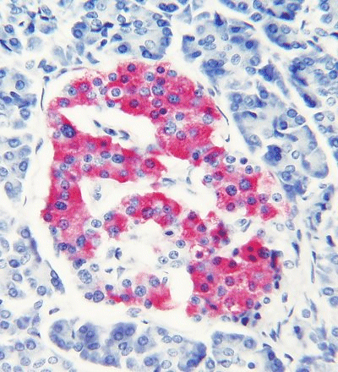
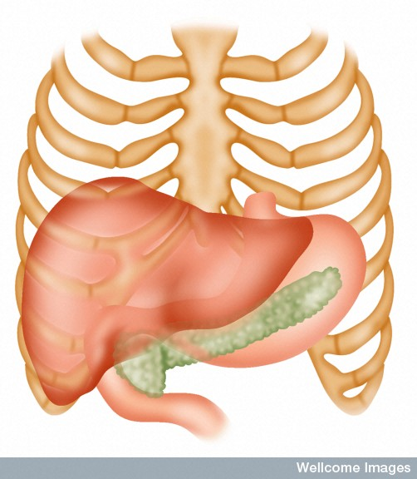
The pancreas
Ilets of Langerhans
Pancreas
Wellcome Photo Library
Edocrine tissue in the pancreas (the islets of Langerhans) secrete hormones that regulate the blood sugar level.

Slide 15
Pancreas
Gland | Principle hormones | Action
Islets of Langerhans Beta-cells | Insulin | Lowers blood sugar levels
Alpha-cells | Glucagon | Raises sugar levels

Slide 16
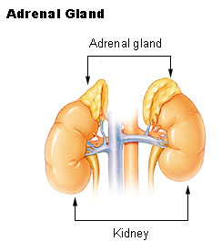

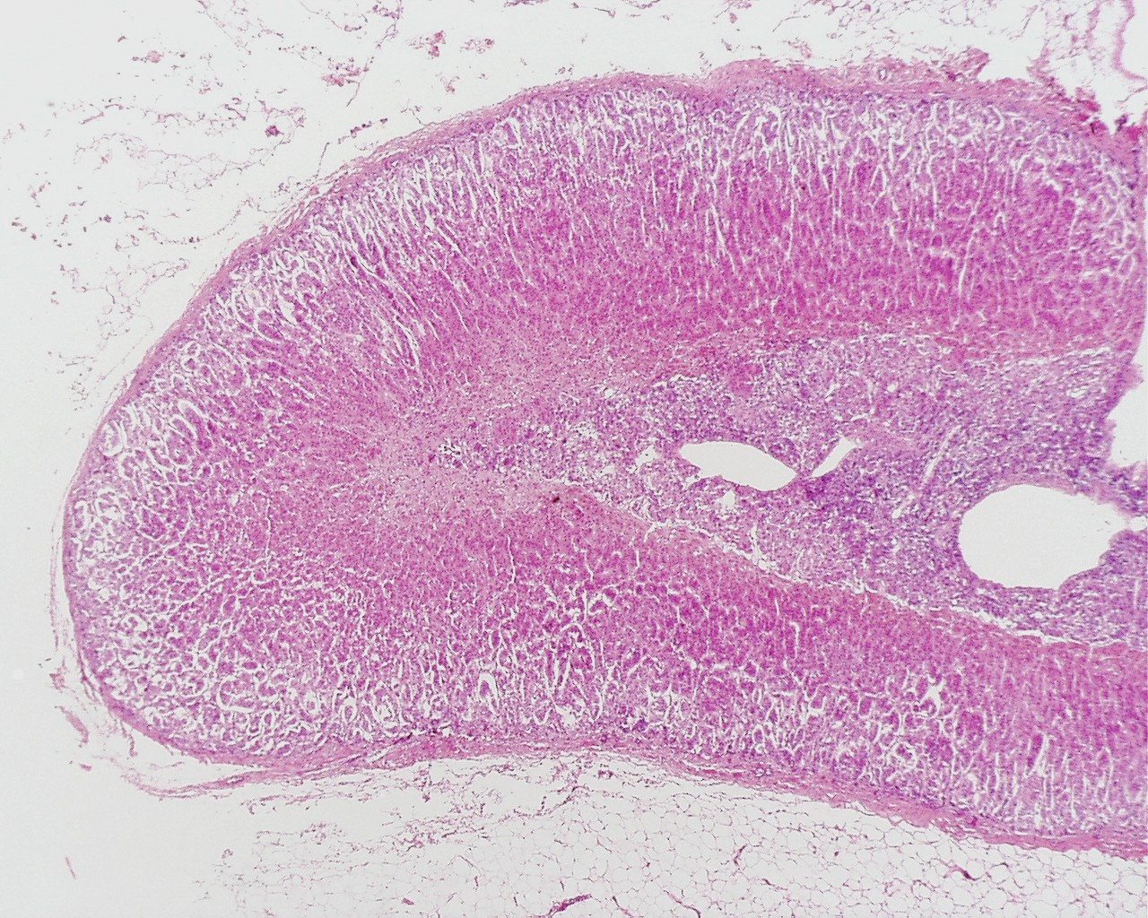
Adrenal gland
Adrenal cortex
Adrenal medulla
Lutz Slomianka, ANHB_UWA

Slide 17
Adrenal gland
Gland | Principle hormones | Action
Adrenal cortex | Mineralocorticoids e.g. aldosterone | Sodium metabolism
 | Glucocorticoids e.g. cortisol | Stress response/glucose metabolism
 | Gonadocorticoids e.g. testosterone | Secondary sexual characteristics
Adrenal medulla | Adrenaline (epinephrine) | Fight or flight response
 | Noradrenaline (norepinephrine)

Slide 18
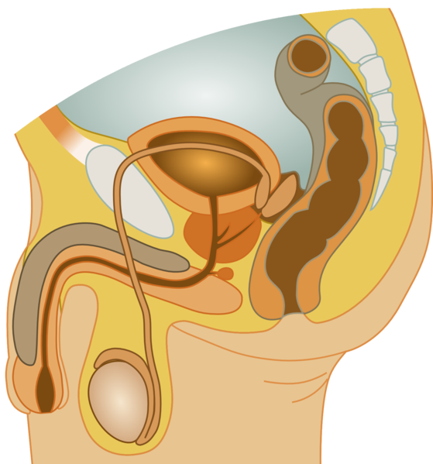
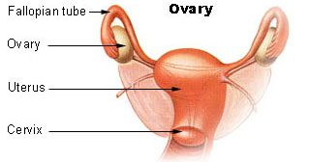
Gonads
Male testes
Female ovaries

Slide 19
The gonads
Gland | Principle hormones | Action
Male gonads The testes | Testosterone | Male secondary sexual characteristics
Female gonads The ovaries | Oestrogen (estrogen) Progesterone | Female secondary sexual characteristics Development of the endometrium Maintenance of endometrium

Slide 20
Regulation of the ovarian and menstrual cycles
The ovarian cycle (the monthly sequence of changes that take place in the ovaries) is regulated by the pituitary hormones follicle stimulating hormone (FSH) and luteinising hormone (LH).
The menstrual cycle (the monthly sequence of changes that take place in the uterus) is regulated by the ovarian hormones estrogen and progesterone.
Both cycles are regulated by complex feedback processes.

Slide 21
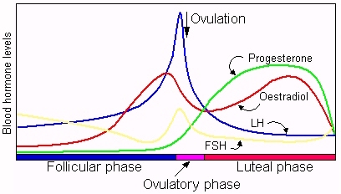
Hormonal control of ovarian/menstrual cycle

Slide 22
Hormonal regulation
Immature follicle
Mature
follicle
Corpus luteum
Corpus albicans
Ovulation
37°C
BODY TEMPERATURE
36°C
MENSTRUAL
PHASE
PROLIFERATIVE
PHASE
SECRETORY
PHASE
ENDOMETRIUM
1
7
14
21
28
DAYS

Slide 23
Feedback regulation of the ovarian and menstrual cycles
Hypothalamus
FSH
LH
NEGATIVE
FEEDBACK
NEGATIVE
FEEDBACK
Estrogen
Progesterone

Slide 24
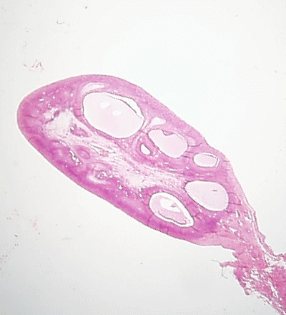
Follicle stimulating hormone (FSH)
Anterior pituitary hormone
Target – ovarian follicle
Role – maturation of ovarian follicle
Predominant in first part of cycle
Developing ovarian follicles
G Meyer, ANHB-UWA

Slide 25
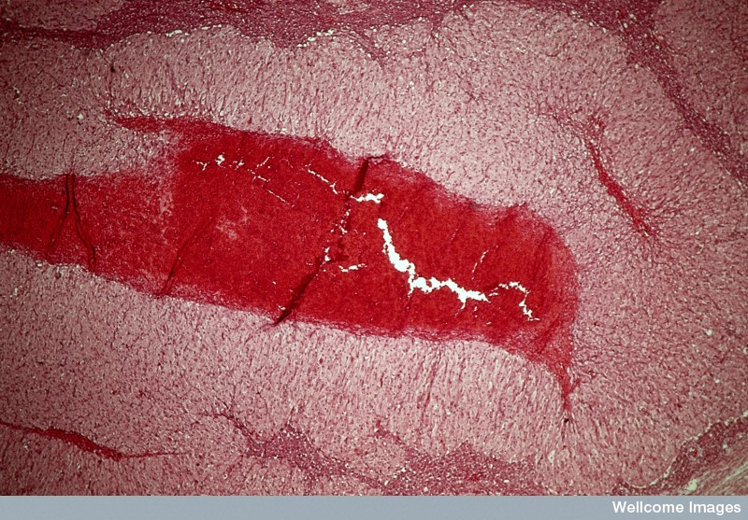
Luteinising hormone (LH)
Anterior pituitary hormone
Target – corpus luteum
Roles
  ovulation
  maintenance of corpus luteum
Predominant in second part of cycle
Corpus luteum
Wellcome Photo Library

Slide 26
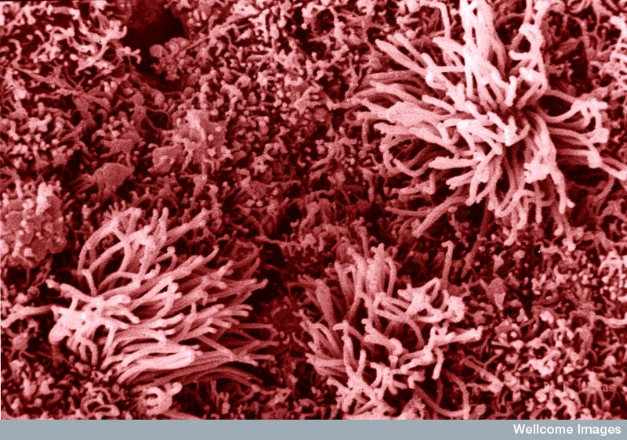
Oestrogen (estrogen)
Ovarian hormone (ovarian follicle)
Target – endometrium
Role – repair of endometrium after menstruation
Predominant in first part of cycle
Non-receptive endometrium
Yorgos Nikas, Wellcome Images

Slide 27
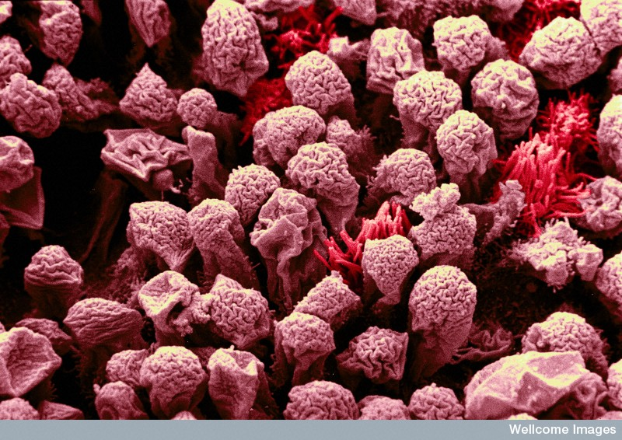
Progesterone
Ovarian hormone (corpus luteum)
Target – endometrium
Role – maintenance of endometrium
Predominant in second part of cycle
Receptive endometrium
Yorgos Nikas, Wellcome Images

